Slide 1
Political science introduction lecture 3
Marem Buzurtanova
Al-Farabi KazNU
Almaty 2022

Slide 2
Political science introduction lecture 3
Political thought in the XIX century – lecture outline:
The background:
The XIX century overview;
Modernity;
Conservatism, liberalism and socialism as major political ideologies.
The thinkers:
Edmund Burke;
John Stuart Mill;
Karl Marx.

Slide 3
Political science introduction lecture 3
The 19th century saw large amounts of social change:
First and Second Industrial Revolutions
massive urbanization
higher levels of productivity, profit and prosperity.
European imperialism brought much of South Asia, Southeast Asia and almost all of Africa under colonial rule
the British Empire, the Russian Empire, the United States, the French Empire, the Austro-Hungarian Empire
Revolutions throughout Europe in 1848
American Civil War

Slide 4
Political science introduction lecture 3
The 19th century - Science and Technology
Discoveries | Medicine | Inventions
1859: Darwin and On the Origin of Species 1865: Mendel formulates his laws of inheritance 1869: Mendeleev and the Periodic table 1873: Maxwell's A Treatise on Electricity and Magnetism 1896: Becquerel discovers radioactivity 1895: Röntgen identifies x-rays. | 1804: Morphine 1842: Anesthesia 1847: Chloroform 1885: Pasteur and the first vaccine 1889: Aspirin patented | 1804: First steam locomotive 1825: The Stockton and Darlington Railway, the first in the world 1826: Internal combustion engine 1829: First electric motor 1856: World's first oil refinery 1858: First true sound recording 1863: First section of the London Underground 1866: Successful transatlantic telegraph cable 1867: Alfred Nobel and dynamite 1884: Sir Hiram Maxim and Machine gun 1886: Karl Benz and the first commercial automobile

Slide 5
Political science introduction lecture 3
Modernity (modern way of life, of thinking, of being) is a more complex and broad concept that Renaissance or Enlightenment describing a society formed by capitalism, industrialization, urbanization, secularization, institutions and civil society:
people are independent rational actors, while in a traditional society, people follow the ways of their fathers and grandfathers;
physical (geographical) and social mobility increases considerably and leads to the changes of unprecedented scope in all aspects of life;
constant and rapid economic growth, technical development, and progress.

Slide 6
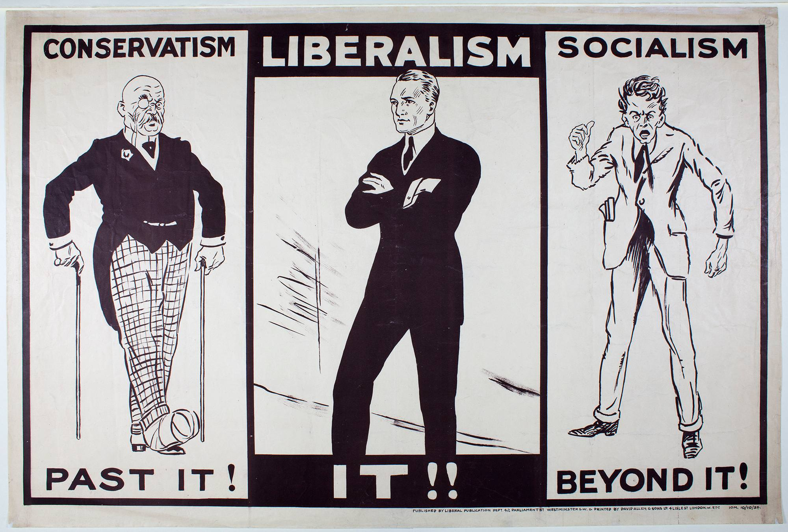
Political science introduction lecture 3

Slide 7
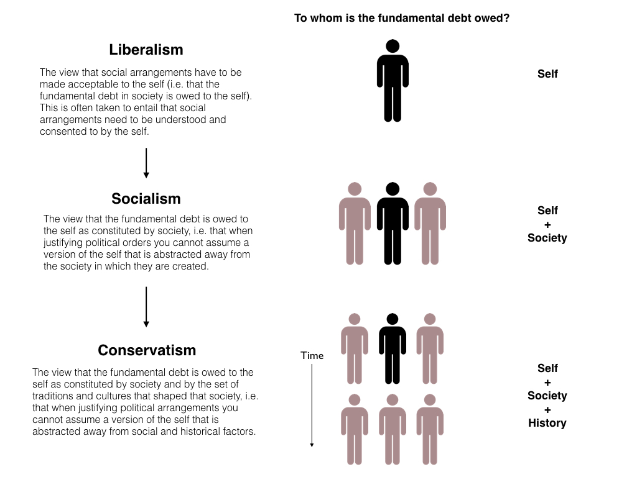
Political science introduction lecture 3

Slide 8
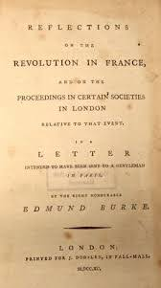
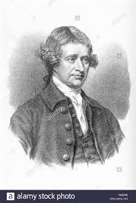
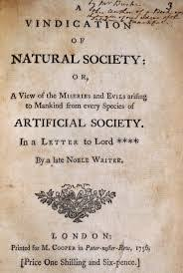
Political science introduction lecture 3
Edmund Burke (1729-1797)

Slide 9
Political science introduction lecture 3
Edmund Burke (1729-1797)
philosopher of conservatism utilitarianism and empiricism
born in Dublin,
Statesman, member of parliament (MP) between with the Whig Party
A Vindication of Natural Society
Reflections on the Revolution in France

Slide 10
Political science introduction lecture 3
Burke: "The laws of commerce are the laws of Nature, and therefore the laws of God." (E. Burke, l.c., pp. 31, 32)
underpinning virtues with manners in society
importance of religious institutions for the moral stability and good of the state
opposition to the French Revolution
property essential to human life
people desire to be ruled and controlled
division of property - basis for social structure (property-based hierarchy) seen as natural
government should focus solely on the duties that a man should have in society as a practicality and not to function to help individuals live their best lives

Slide 11
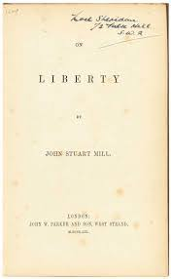
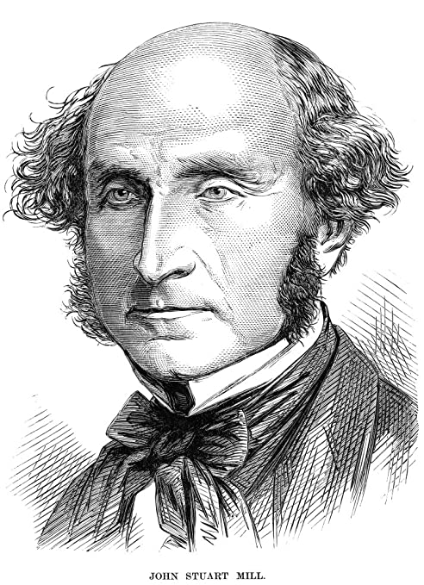
Political science introduction lecture 3
John Stuart Mill (1806 –1873)

Slide 12
Political science introduction lecture 3
Harm Principle
It is not a crime to harm oneself as long as the person doing so is not harming others. He excuses those who are "incapable of self-government" from this principle, such as young children or those living in "backward states of society" … "Despotism is a legitimate mode of government in dealing with Barbarians".
Social Liberty
Liberty as protection from the tyranny of political rulers. people should have the right to have a say in the government's decisions.
Social liberty was the nature and limits of the power which can be legitimately exercised by society over the individual attempted in two ways: first, by obtaining recognition of certain immunities (political liberties or rights); and by establishment of "constitutional checks".

Slide 13
Political science introduction lecture 3
Mill's On Liberty (1859) addresses the nature and limits of the power that can be legitimately exercised by society over the individual:
The sole end for which mankind are warranted, individually or collectively, in interfering with the liberty of action of any of their number, is self-protection. That the only purpose for which power can be rightfully exercised over any member of a civilized community, against his will, is to prevent harm to others. His own good, either physical or moral, is not sufficient warrant. Over himself, over his own body and mind, the individual is sovereign.

Slide 14
Political science introduction lecture 3
Freedom of Speech
Free discourse is a necessary for intellectual and social progress. To allow people to air false opinions is productive for two reasons.
First, individuals are more likely to abandon erroneous beliefs if they are engaged in an open exchange of ideas.
Second, by forcing other individuals to re-examine and re-affirm their beliefs in the process of debate, these beliefs are kept from declining into mere dogma.

Slide 15
Political science introduction lecture 3
Economic Philosophy
Free market and utilitarian society, competition; "equality of taxation"; progressive taxation penalizes those who worked harder and saved more and was therefore "a mild form of robbery".
Representative Government: extensive participation by citizens and enlightened competence of rulers.
plural voting, in which more competent citizens are given extra votes incompetence of the masses could be overcome if they were given a chance to take part in politics, especially at the local level;
public education to the working class.

Slide 16
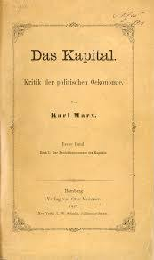
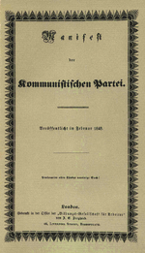
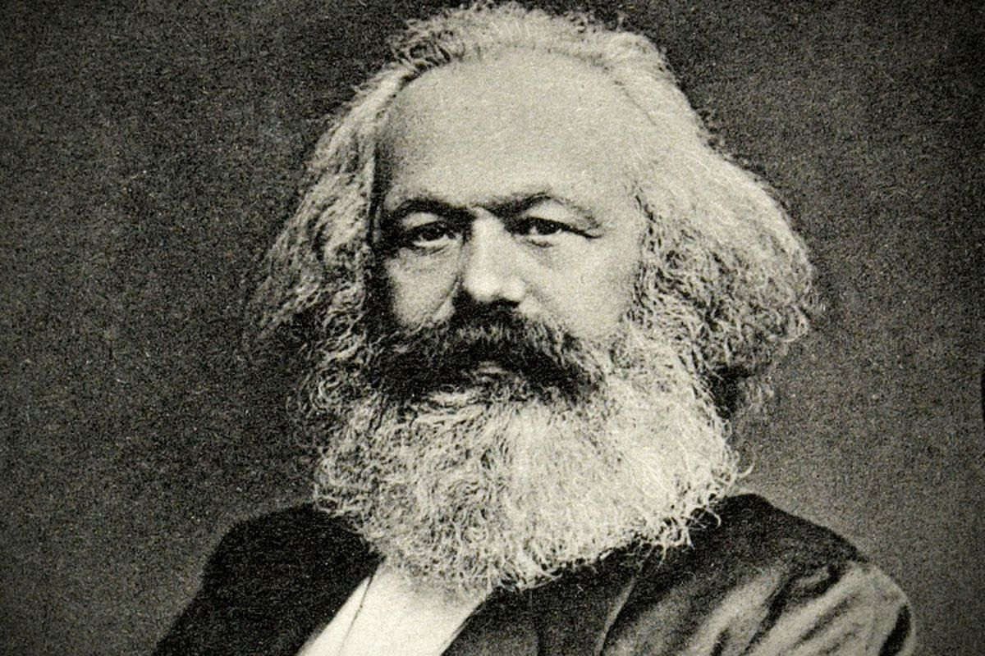
Political science introduction lecture 3
Karl Heinrich Marx (1818 – 1883)

Slide 17
Political science introduction lecture 3
Karl Marx (1818 – 1883)
German philosopher, economist, historian, sociologist, political theorist, journalist and socialist revolutionary
stateless and lived in exile in London for decades,
collaborated with German thinker Friedrich Engels
The Communist Manifesto (1848) pamphlet
Das Kapital (1867–1883)
a founder (with Durkheim and Weber) school of social theory.
Marxism and Historical Materialism

Slide 18
Political science introduction lecture 3
Marx's Thought Influences:
Hegel's philosophy and German philosophical materialism of Feuerbach
Classical political economy of Adam Smith and David Ricardo
French socialism Rousseau, Saint-Simon, Proudhon and Fourier

Slide 19
Political science introduction lecture 3
alienation
Materialist Concept of History
Means of Production Mode of Production
Surplus Value

Slide 20
Political science introduction lecture 3
Karl Marx's describes the social alienation of people from aspects of their human nature as a consequence of living in a society of stratified social classes. The alienation from the self is a consequence of being a mechanistic part of a social class, the condition of which estranges a person from their humanity.

Slide 21
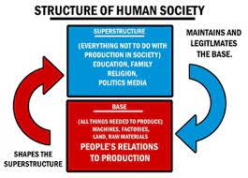
Political science introduction lecture 3

